Slide 1
Chapter 4: Threads

Slide 2
Objectives
To introduce the notion of a thread — a fundamental unit of CPU utilization that forms the basis of multithreaded computer systems
To discuss the APIs for the Pthreads, Win32, and Java thread libraries
To examine issues related to multithreaded programming

Slide 3
Thread
Thread is an execution unit which consists of its own program counter, a stack, and a set of registers.
Threads are also known as Lightweight processes.
Threads are popular way to improve application through parallelism. The CPU switches rapidly back and forth among the threads giving illusion that the threads are running in parallel.

Slide 4
Motivation
Threads run within application
Multiple tasks with the application can be implemented by separate threads
  Update display
  Fetch data
  Spell checking
  Answer a network request
Process creation is heavy-weight while thread creation is light-weight
Can simplify code, increase efficiency
Kernels are generally multithreaded

Slide 5

Single and Multithreaded Processes

Slide 6
Threads
Threads are easier to create than processes since they don't require a separate address space. Address space is the amount of memory allocated for all possible addresses for a computational entity
Multithreading requires careful programming since threads share data strucures that should only be modified by one thread at a time. Unlike threads, processes don't share the same address space.
Threads are considered lightweight because they use far less resources than processes.
Processes are independent of each other. Threads, since they share the same address space are interdependent, so caution must be taken so that different threads don't step on each other.
A process can consist of multiple threads.

Slide 7
Threads Vs. Processes
A thread operates in much the same way as a process:
  can be in one of the various states;
  executes (within a process and shares the CPU); issues system calls to the OS.
Creating a thread, however, is far less expensive than creating a process, since all resources need not be duplicated
  Especially the address space

Slide 8
Threads Vs. Processes
Switching between threads within a process is also cheaper than switching between different processes.
Threads within a process share resources conveniently and efficiently compared to separate processes.
  However, threads within a process are NOT independent and are NOT protected against each other.

Slide 9
Threads: an example
A good example of an application that could make use of threads is a file server on a local area network (LAN).
A ‘‘controller’’ thread accepts file service requests and spawns a ‘‘worker’’ thread for each request, thereby easily handling many requests concurrently.
When a worker thread finishes servicing a request, it is destroyed.

Slide 10
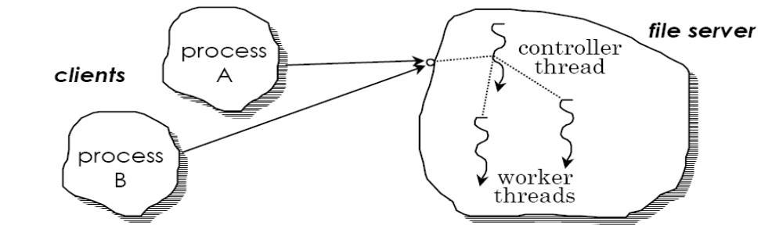
Threads: an example

Slide 11
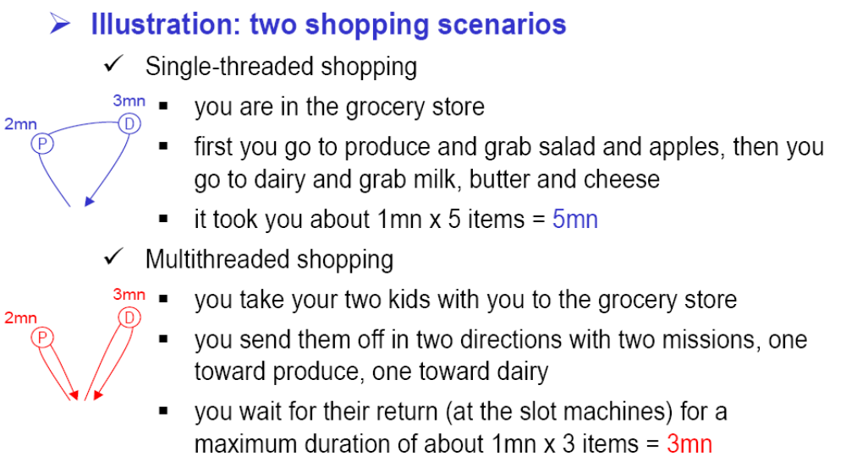
Practical uses of Multithreading

Slide 12
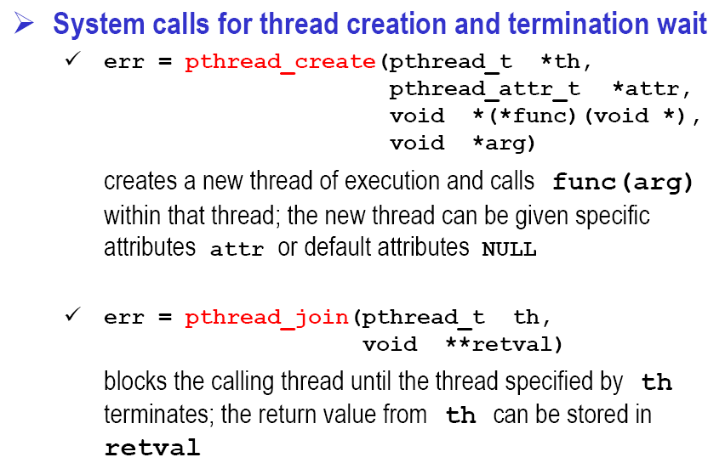
Practical uses of Multithreading

Slide 13
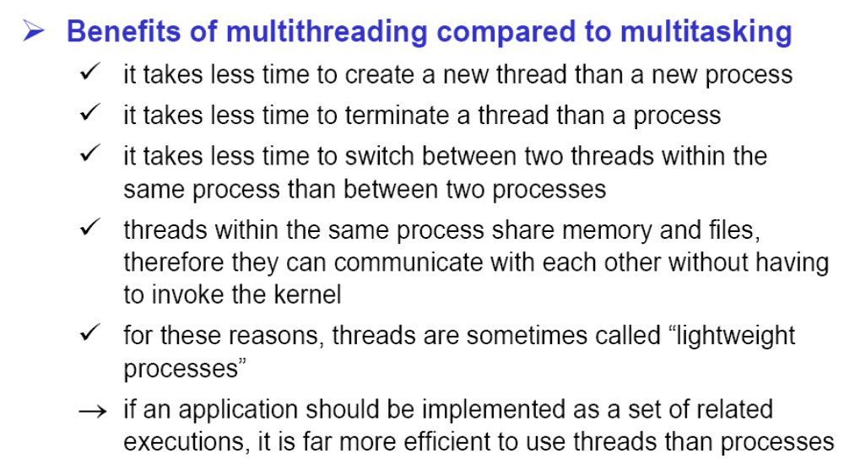
Practical uses of Multithreading

Slide 14
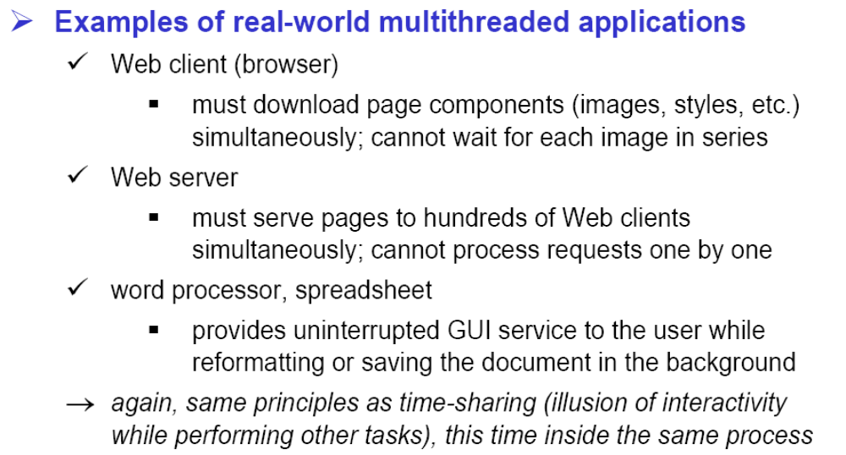
Practical uses of Multithreading

Slide 15
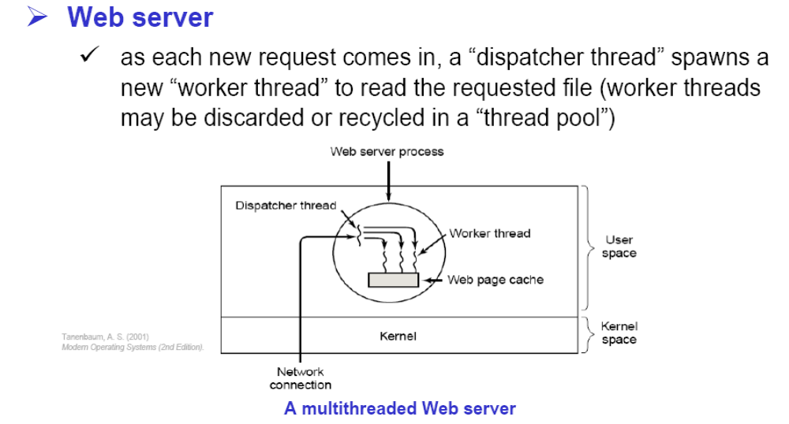
Practical uses of Multithreading

Slide 16
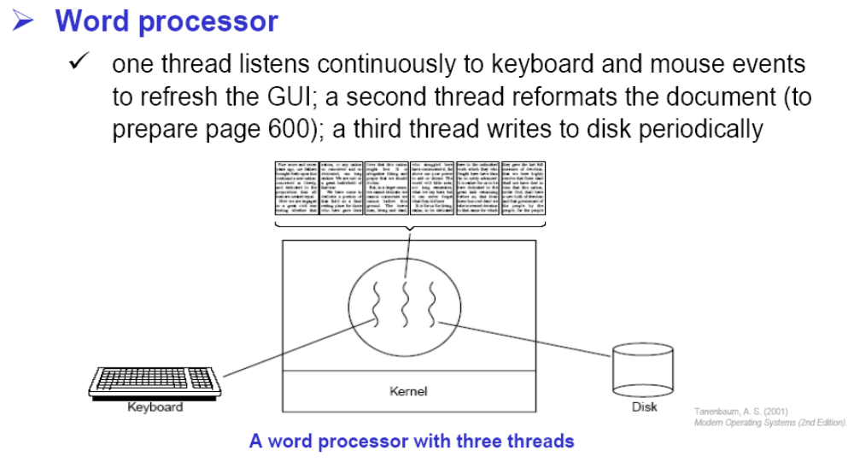
Practical uses of Multithreading

Slide 17
Threads implementations
User level
User threads are supported above the kernel and are managed without kernel support. These are the threads that application programmers use in their programs.
Created and manipulated using a set of library routines
Thread creation and scheduling is done in user space without kernel intervention
Each thread gets partial time quantum of its containing process

Slide 18
User Level Threads
User level libraries perform scheduling and dispatching because OS is unaware of threads.
More portable → independent of OS
User specific scheduling algorithms
A system call by one thread blocks the entire set of threads associated with a process because it blocks the process itself
Less costly (thread) operations – no system calls to do individual thread operations → fast to create and manage.

Slide 19
User Level Threads
Do not scale well to multiprocessor systems.
A thread can blocks an entire process. So processes with lower priority threads executes

Slide 20
Threads implementations
Kernel level
Created using system calls
Creation, management and scheduling is done by kernel in kernel space
Threads operate independently within a single address space so one can be blocked while others continue to execute
Greater throughput, but more expensive (thread) operations

Slide 21
Kernel Level Threads
Kernel can dispatch a process’s threads to several processors
OS can dispatch a process’s ready thread even if one of its threads is blocked
In priority based scheduling, a process can adjust the level of service each thread receives from OS by assigning priorities
Increased overhead
Less portable

Slide 22
User Level thread Vs Kernel Level thread
USER LEVEL THREAD | KERNEL LEVEL THREAD
User thread are implemented by users. | kernel threads are implemented by OS.
OS doesn’t recognized user level threads. | Kernel threads are recognized by OS.
Implementation of User threads is easy. | Implementation of Kernel thread is complicated.
Context switch time is less. | Context switch time is more.
Context switch requires no hardware support. | Hardware support is needed.
If one user level thread perform blocking operation then entire process will be blocked. | If one kernel thread perform blocking operation then another thread can continue execution.
Example : Java thread, POSIX threads. | Example : Window Solaris.

Slide 23
Hybrid Approach
Recall the two advantages of the previous approaches: we want cheap thread overhead (user level) yet still have the independence offered by kernel threads
The hybrid approach combines these e.g. Solaris threads
We have both kernel and user-level threads
This is illustrated in the following diagram:

Slide 24
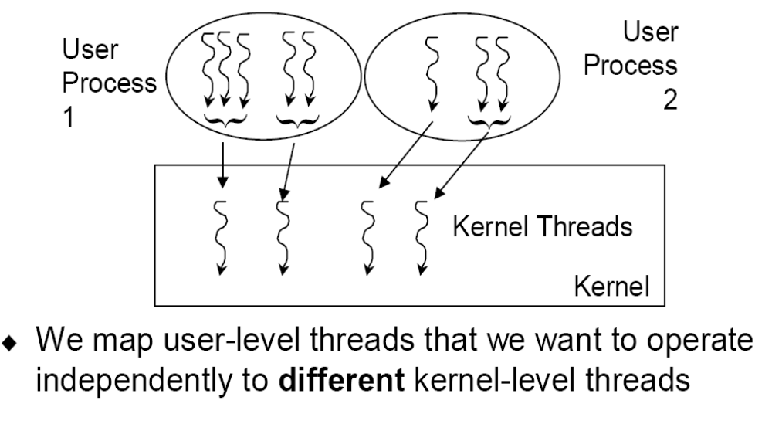
Hybrid Approach

Slide 25
Hybrid Approach
User-level threads that don't have to operate independently can be mapped to a single kernel-level thread and thereby be executed more efficiently
There is still some overhead for the kernel level threads, but they are hopefully used only when the advantages they offer are needed!
Best of both worlds

Slide 26
Benefits
Responsiveness
  Multithreading an interactive application may allow a program to continue running even if part of it is blocked or is performing a lengthy operation, thereby increasing responsiveness to the user.
Resource Sharing
  Processes may only share resources through techniques such as shared memory or message passing. Such techniques must be explicitly arranged by the programmer. However, threads share the memory and the resources of the process to which they belong by default
Economy
  Allocating memory and resources for process creation is costly. Because threads share the resources of the process to which they belong, it is more economical to create and context-switch threads
Scalability
  The benefits of multithreading can be greatly increased in a multiprocessor architecture, where threads may be running in parallel on different processors.

Slide 27
Multicore Programming
Multicore systems putting pressure on programmers, challenges include:
  Dividing activities
    This involves examining applications to find areas that can be divided into separate, concurrent tasks and thus can run in parallel on individual cores.
  Balance
    While identifying tasks that can run in parallel, programmers must also ensure that the tasks perform equal work of equal value.
  Data splitting
    Just as applications are divided into separate tasks, the data accessed and manipulated by the tasks must be divided to run on separate cores.
  Data dependency
    The data accessed by the tasks must be examined for dependencies between two or more tasks. In instances where one task depends on data from another, programmers must ensure that the execution of the tasks is synchronized to accommodate the data dependency
  Testing and debugging
    When a program is running in parallel on multiple cores, there are many different execution paths.
    Testing and debugging such concurrent programs is inherently more difficult than testing and debugging single-threaded applications.

Slide 28

Multithreaded Server Architecture

Slide 29
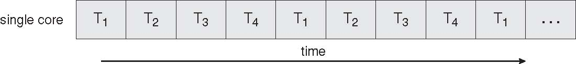
Concurrent Execution on a
Single-core System

Slide 30
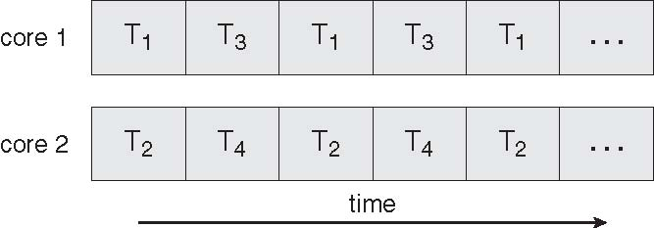
Parallel Execution on a
Multicore System

Slide 31
User Threads
Thread management done by user-level threads library
Three primary thread libraries:
  POSIX Pthreads
  Win32 threads
  Java threads

Slide 32
Kernel Threads
Supported by the Kernel
Examples
  Windows XP/2000
  Solaris
  Linux
  Tru64 UNIX
  Mac OS X

Slide 33
Multithreading Models
The user threads must be mapped to kernel threads, by one of the following strategies:
Many-to-One
One-to-One
Many-to-Many

Slide 34
Many-to-One
Many user-level threads mapped to single kernel thread
Thread management is done by the thread library in user space, so it is efficient
but the entire process will block if a thread makes a blocking system call
because only one thread can access the kernel at a time, multiple threads are unable to run in parallel on multiprocessors
Examples:
  Solaris Green Threads
  GNU Portable Threads

Slide 35
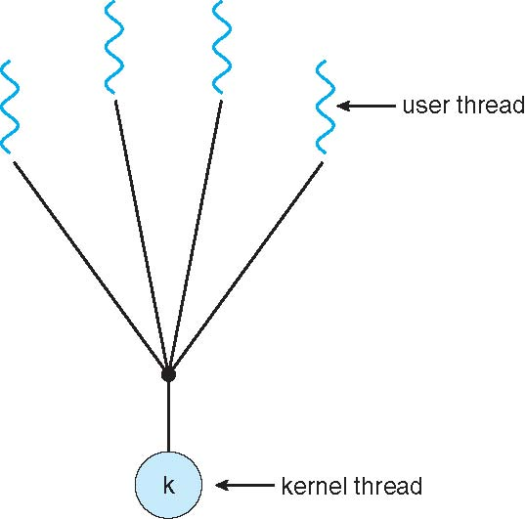
Many-to-One Model

Slide 36
One-to-One
Each user-level thread maps to kernel thread
It provides more concurrency than the many-to-one model by allowing another thread to run when a thread makes a blocking system call.
it also allows multiple threads to run in parallel on multiprocessors.
The only drawback to this model is that creating a user thread requires creating the corresponding kernel thread.
Examples
  Windows NT/XP/2000
  Linux
  Solaris 9 and later

Slide 37
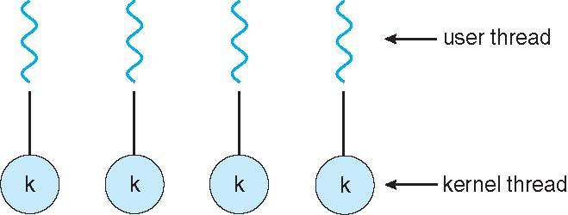
One-to-one Model

Slide 38
Many-to-Many Model
Allows many user level threads to be mapped to many kernel threads
Allows the operating system to create a sufficient number of kernel threads
Solaris prior to version 9
Windows NT/2000 with the ThreadFiber package

Slide 39

Many-to-Many Model

Slide 40
Two-level Model
Similar to M:M, except that it allows a user thread to be bound to kernel thread
Examples
  IRIX
  HP-UX
  Tru64 UNIX
  Solaris 8 and earlier

Slide 41
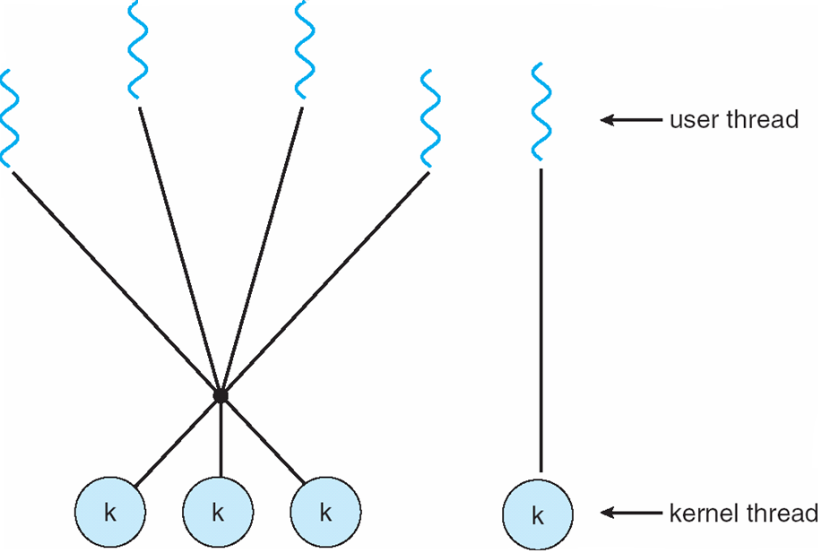
Two-level Model

Slide 42
Thread Libraries
Thread library provides programmer with API for creating and managing threads
Two primary ways of implementing
  Library entirely in user space
  Kernel-level library supported by the OS

Slide 43
Pthreads
May be provided either as user-level or kernel-level
A POSIX standard (IEEE 1003.1c) API for thread creation and synchronization
API specifies behavior of the thread library, implementation is up to development of the library
Common in UNIX operating systems (Solaris, Linux, Mac OS X)

Slide 44
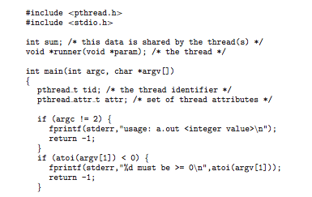
Pthreads Example

Slide 45
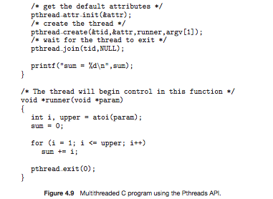
Pthreads Example (Cont.)

Slide 46
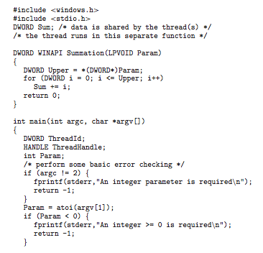
Win32 API Multithreaded C Program

Slide 47
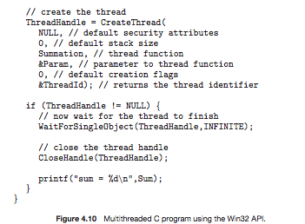
Win32 API Multithreaded C Program (Cont.)

Slide 48
Java Threads
Java threads are managed by the JVM
Typically implemented using the threads model provided by underlying OS
Java threads may be created by:
  Extending Thread class
  Implementing the Runnable interface

Slide 49
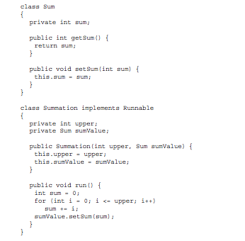
Java Multithreaded Program

Slide 50
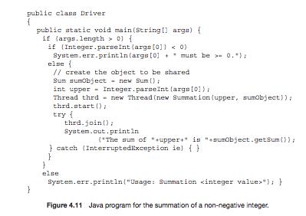
Java Multithreaded Program (Cont.)

Slide 51
Threading Issues
Semantics of fork() and exec() system calls
  fork starts a new process which is a copy of the one that calls it, while exec replaces the current process image with another (different) one.
Thread cancellation of target thread
Signal handling
  Synchronous and asynchronous
Thread pools
Thread-specific data
Scheduler activations

Slide 52
Thread Cancellation
Terminating a thread before it has finished
Two general approaches:
  Asynchronous cancellation terminates the target thread immediately.
  Deferred cancellation allows the target thread to periodically check if it should be cancelled.

Slide 53
Signal Handling
Signals are used in UNIX systems to notify a process that a particular event has occurred.
  synchronous signals
  asynchronous signals
A signal handler is used to process signals
  Signal is generated by particular event
  Signal is delivered to a process
  Once delivered, the signal must be handled.
A signal may be handled by one of two possible handlers:
1. A default signal handler
  that is run by the kernel when handling that signal.
2. A user-defined signal handler
  default action can be overridden by a user-defined signal handler that is called to handle the signal
Some signals (such as changing the size of a window) are simply ignored; others (such as an illegal memory access) are handled by terminating the program.

Slide 54
Handling signals in single-threaded program:
Handling signals in multithreaded program:
However, delivering signals is more complicated in multithreaded programs, where a process may have several threads. Where, then, should a signal be delivered?
In general, the following options exist:
Deliver the signal to the thread to which the signal applies
Deliver the signal to every thread in the process
Deliver the signal to certain threads in the process
Assign a specific thread to receive all signals for the process

Slide 55
asynchronous signals
synchronous signals
APC:
  Although Windows does not explicitly provide support for signals, they can be emulated using asynchronous procedure calls (APCs). The APC facility allows a user thread to specify a function that is to be called when the user thread receives notification of a particular event. As indicated by its name, an APC is roughly equivalent to an asynchronous signal in UNIX
  APC facility is more straightforward, since an APC is delivered to a particular thread rather than a process

Slide 56
Thread Pools
Create a number of threads in a pool where they await work
Advantages:
  Usually slightly faster to service a request with an existing thread than create a new thread
  A thread pool limits the number of threads that exist at any one point . This is particularly important on systems that cannot support a large number of concurrent threads,
The number of threads in the pool can be set heuristically based on factors
  number of CPUs in the system
  the amount of physical memory
  the expected number of concurrent client requests
  More sophisticated thread-pool architectures can dynamically adjust the number of threads in the pool according to usage patterns.

Slide 57
Thread Specific Data
in some circumstances, each thread might need its own copy of certain data. We will call such data thread-specific data
For example, in a transaction-processing system, we might service each transaction in a separate thread. Furthermore, each transaction might be assigned a unique identifier. To associate each thread with its unique identifier, we could use thread-specific data.

Slide 58
Scheduler Activations
Both M:M and Two-level models require communication to maintain the appropriate number of kernel threads allocated to the application
the kernel inform an application about certain events. This procedure is known as an upcall
Scheduler activations provide upcalls - a communication mechanism from the kernel to the thread library
This communication allows an application to maintain the correct number kernel threads

Slide 59

Lightweight Processes
To the user-thread library, the LWP appears to be a virtual processor on which the application can schedule a user thread to run. Each LWP is attached to a kernel thread, and it is kernel threads that the operating system schedules to run on physical processors. If a kernel thread blocks (such as while waiting for an I/O operation to complete), the LWP blocks as well

Slide 60
Operating System Examples
Windows XP Threads
Linux Thread

Slide 61
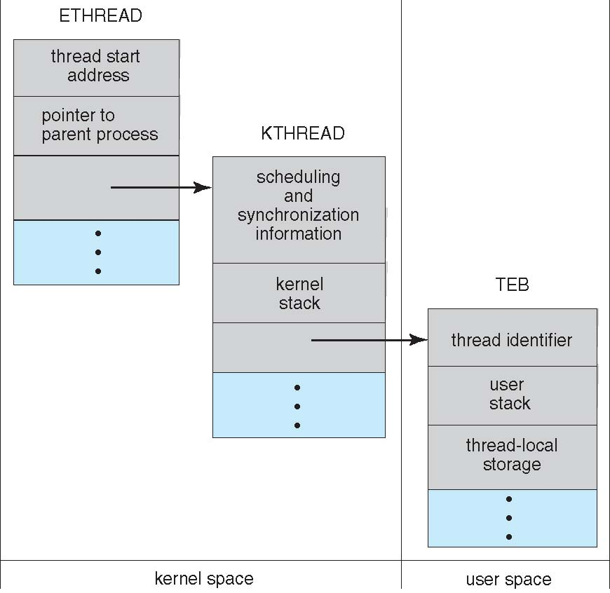
Windows XP Threads Data Structures

Slide 62
Windows XP Threads
Implements the one-to-one mapping, kernel-level
Each thread contains
  A thread id
  Register set
  Separate user and kernel stacks
  Private data storage area
The register set, stacks, and private storage area are known as the context of the threads
The primary data structures of a thread include:
  ETHREAD (executive thread block)
  KTHREAD (kernel thread block)
  TEB (thread environment block)

Slide 63
Linux Threads
Linux refers to them as tasks rather than threads
Thread creation is done through clone() system call
clone() allows a child task to share the address space of the parent task (process)
struct task_struct points to process data structures (shared or unique)

Slide 64
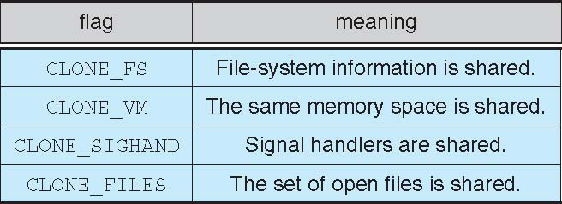
Linux Threads
fork() and clone() system calls
Doesn’t distinguish between process and thread
  Uses term task rather than thread
clone() takes options to determine sharing on process create
struct task_struct points to process data structures (shared or unique)

Slide 65
End of Chapter 4

Slide 66
Chapter 4: Threads
Overview
Multithreading Models
Thread Libraries
Threading Issues
Operating System Examples
Windows XP Threads
Linux Threads

